Slide 1
ML Model
Bianca Bai
Davis Liu
Josh Zheng

Slide 2
Purpose
Predict a student’s current course grade based on:
Past grades (10 previous courses)
Course difficulty (scale 1–10)
Challenge: Student performance is not linear – some improve, some decline, some struggle in hard courses.

Slide 3
Training Data
Created dataset with different student archetypes:
Strong performers – consistently high grades.
Improving students – grades trend upward.
Declining students – grades trend downward.
Strugglers – performance drops significantly in harder courses.
Resilient improvers – start low but improve steadily.
For each student we generate:
Past grades (10 values)
Difficulty of the course(1–10)
Current grade (target)

Slide 4
Model Architecture
Past grades are a sequence (time series)
Students may improve, decline, or fluctuate
Need to capture trends, not just averages
LSTM Encoder for past grades (sequence of 10)
Sequence of Grades
Linear
LSTM
Relu
Output
Linear
Sequence of Grades
Relu
Linear

Slide 5
Training Setup
Loss function: Mean Squared Error (MSE)
Optimizer: Adam, learning rate 0.001
Data: Synthetic dataset of 10000 samples
Epochs: 150 for convergence

Slide 6
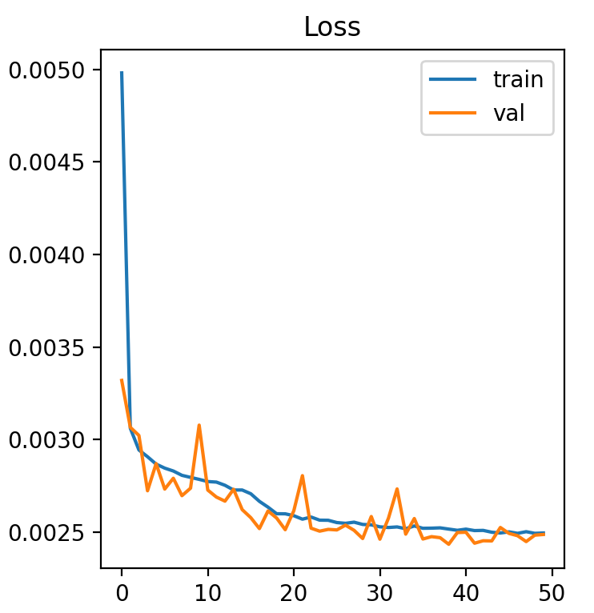
Results
Validation Accuracy: 71.3%

Slide 7
Future Improvements
More finetuning could be done
Customized loss function (Penalties)
Hyperparameter optimizing
Using real world data

Slide 8
Thank you

